Slide 1
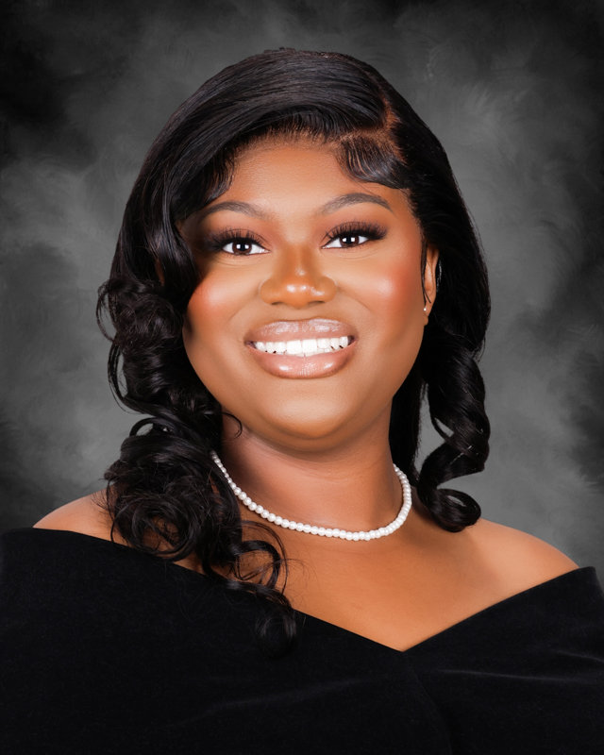
PCHS Class of 2025
Neve’ah Able

Slide 2
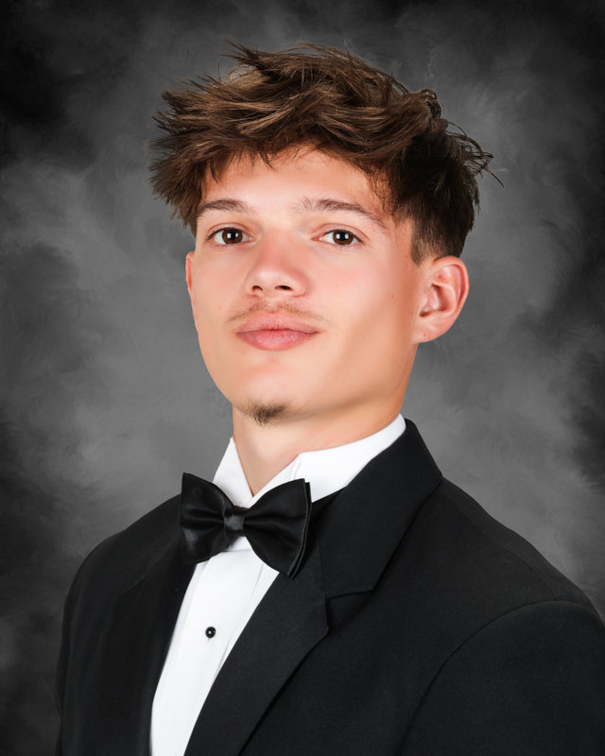
PCHS Class of 2025
Tristan Acevedo

Slide 3
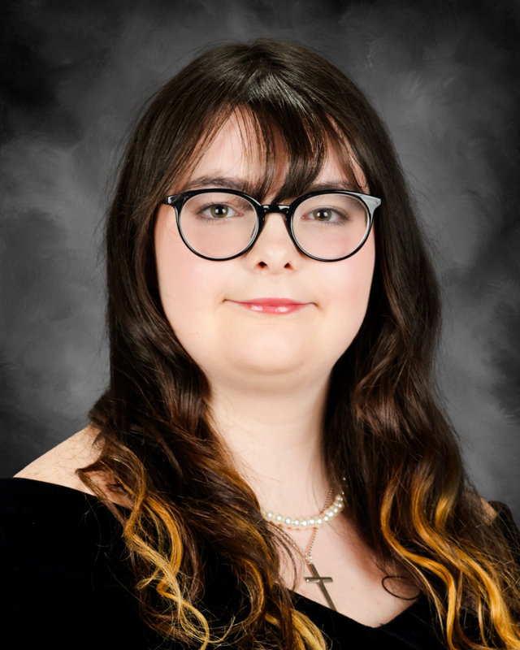
PCHS Class of 2025
Emma Aikens

Slide 4
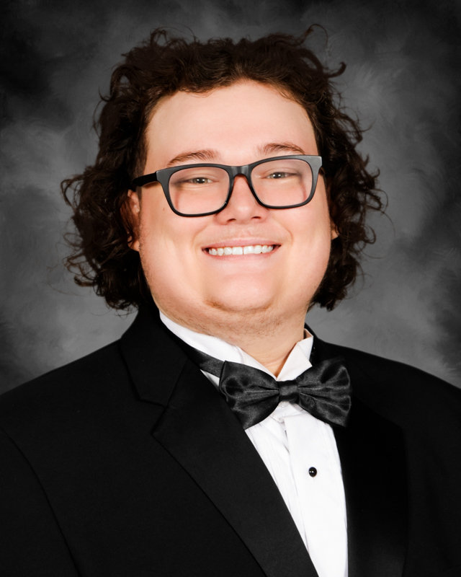
PCHS Class of 2025
Hunter Aikens

Slide 5
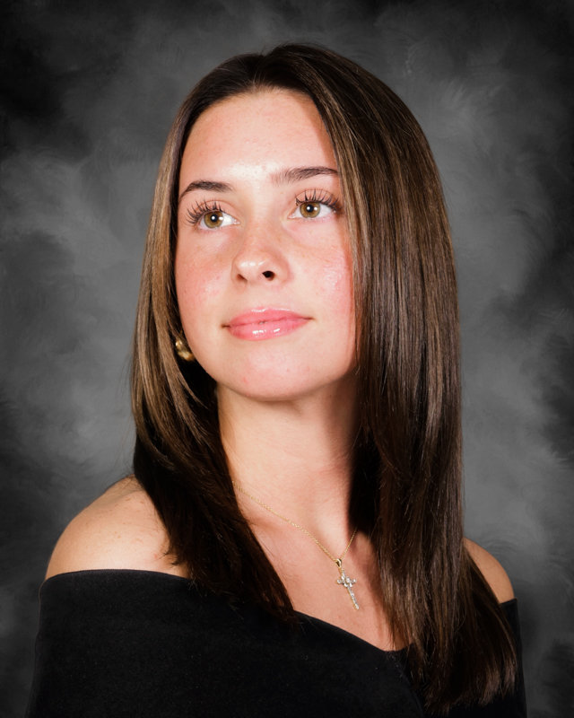
PCHS Class of 2025
Trinity Aikens

Slide 6
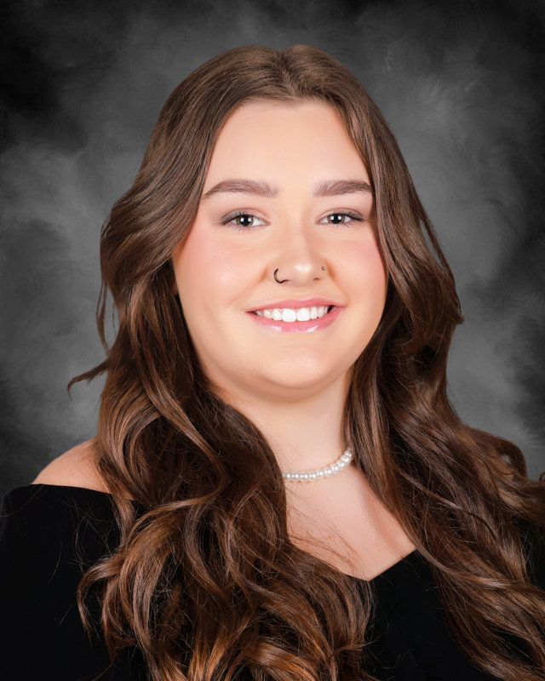
PCHS Class of 2025
Haven Allen

Slide 7
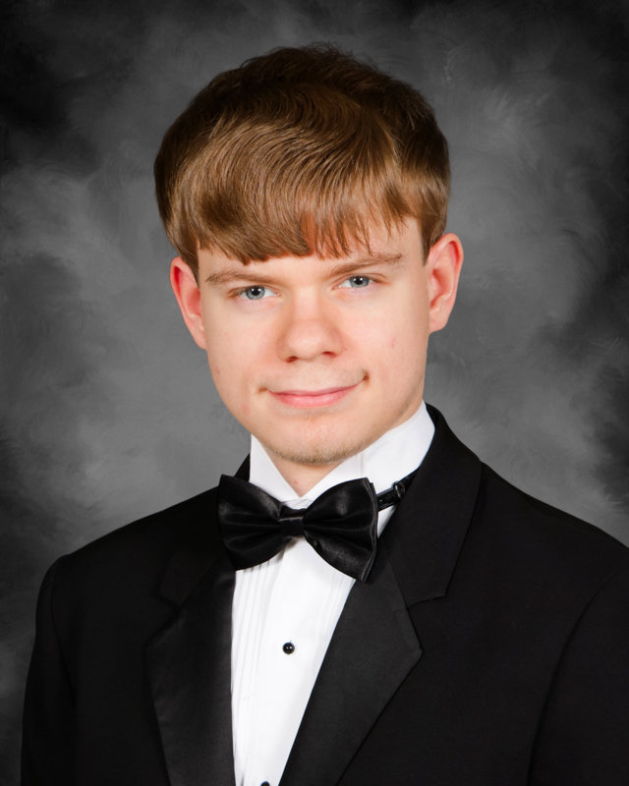
PCHS Class of 2025
William Allen

Slide 8
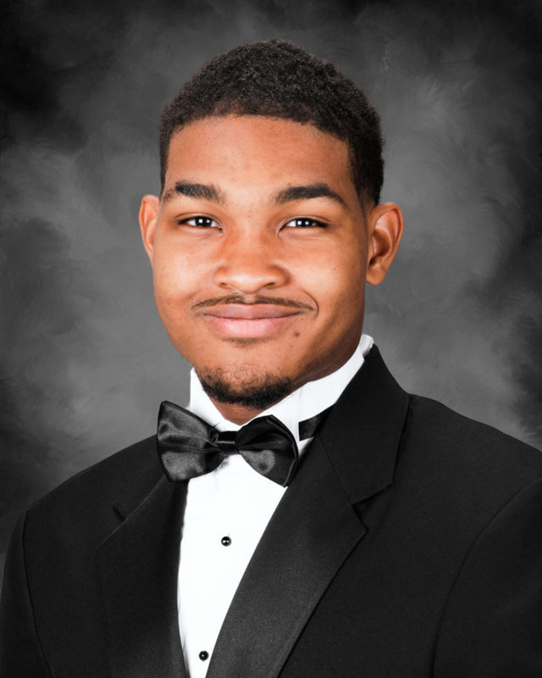
PCHS Class of 2025
Gary Alston

Slide 9
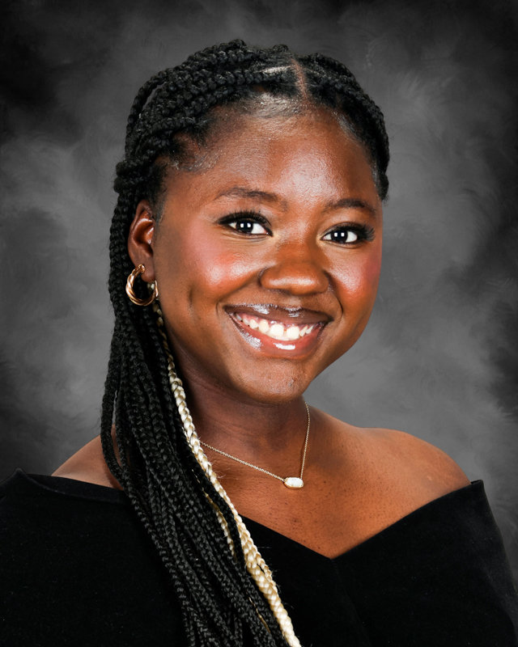
PCHS Class of 2025
Ginikachukwu Amaeze

Slide 10
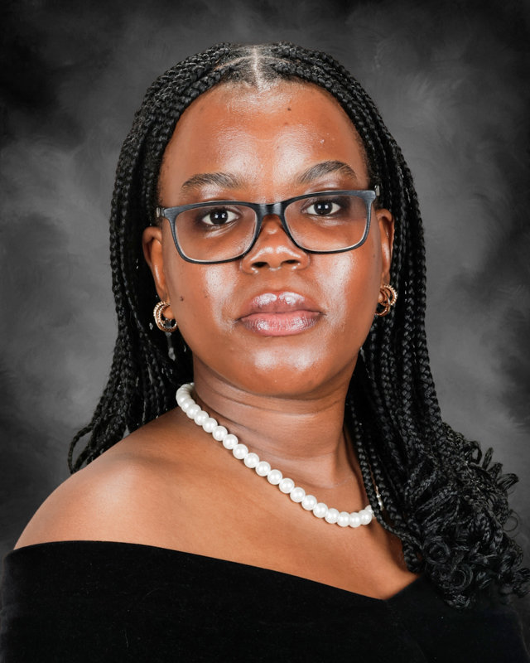
PCHS Class of 2025
Margaret Anyanwu

Slide 11
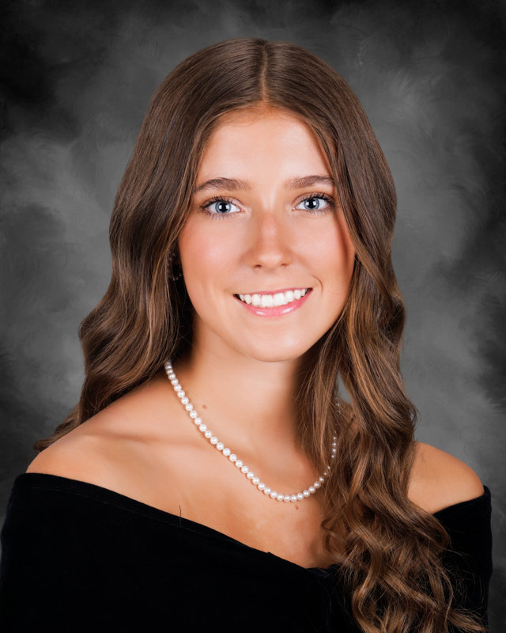
PCHS Class of 2025
Megan Armstrong

Slide 12
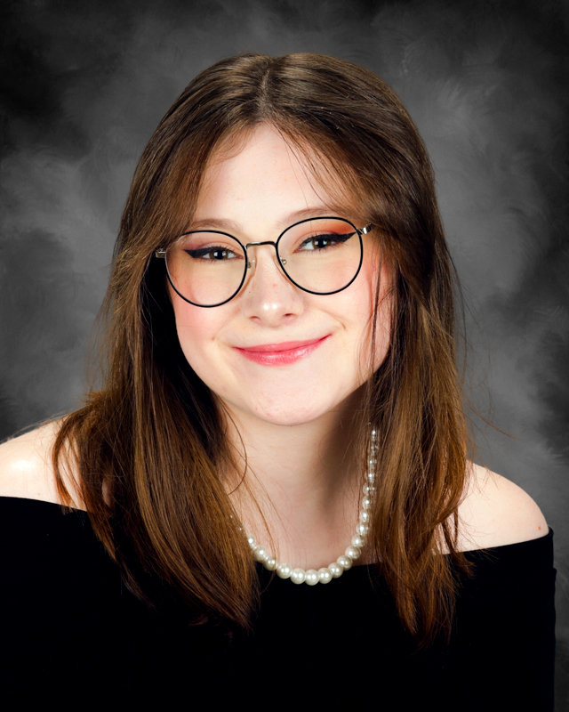
PCHS Class of 2025
Alexis Austin

Slide 13
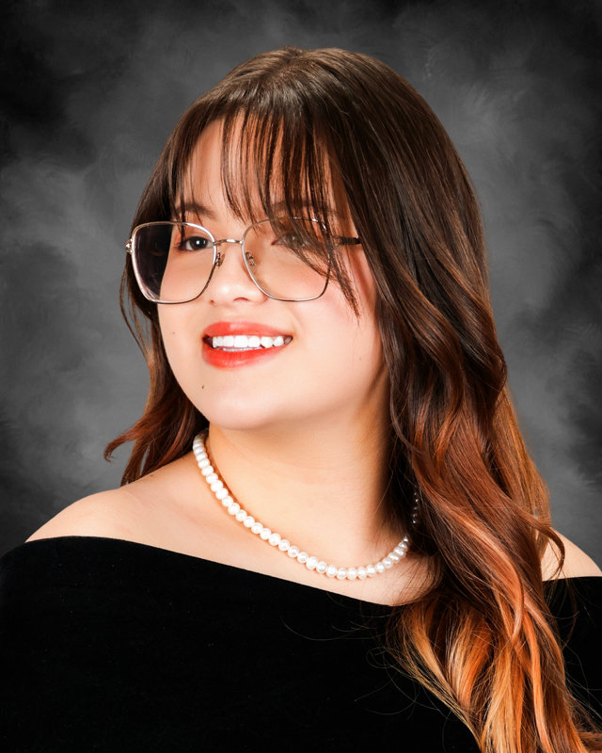
PCHS Class of 2025
Melina Austin

Slide 14
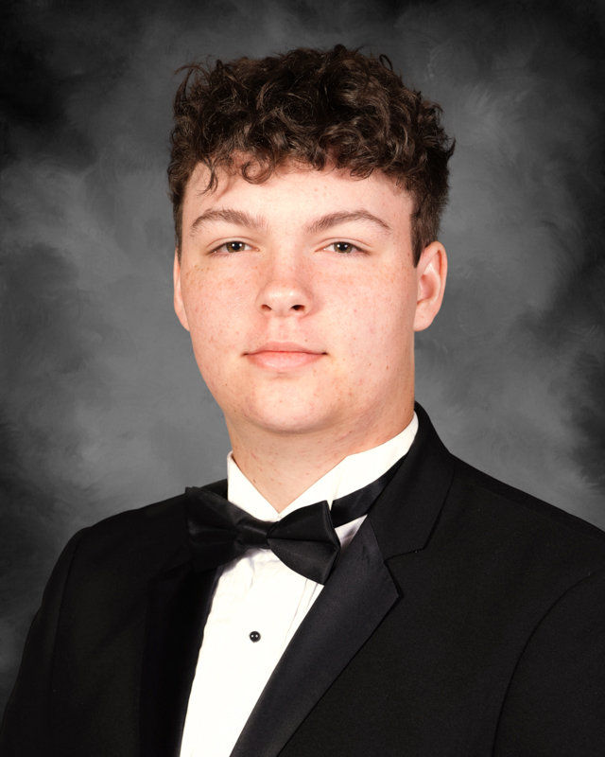
PCHS Class of 2025
Michael Baker

Slide 15
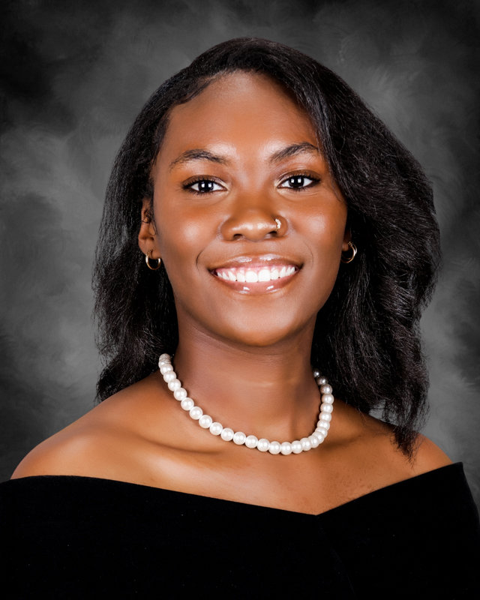
PCHS Class of 2025
Jayla Beck

Slide 16
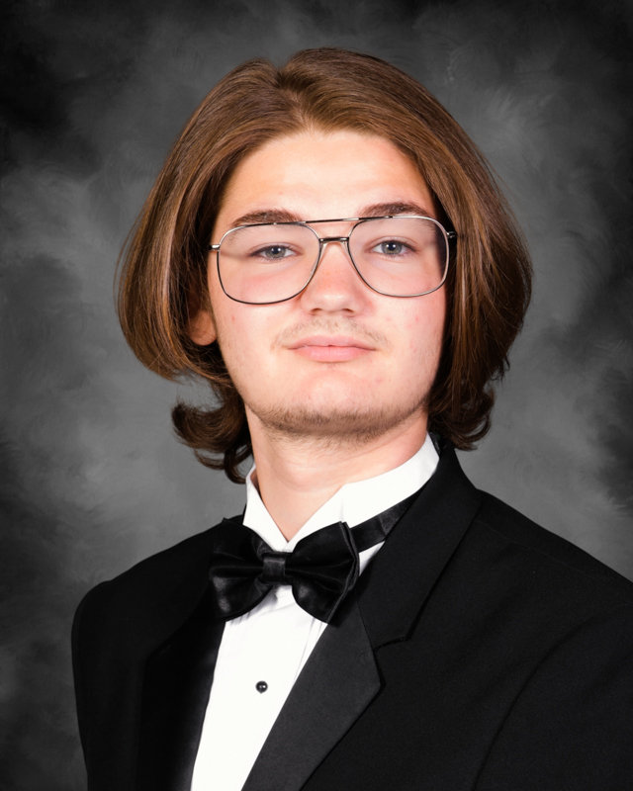
PCHS Class of 2025
Elijah Bedor

Slide 17
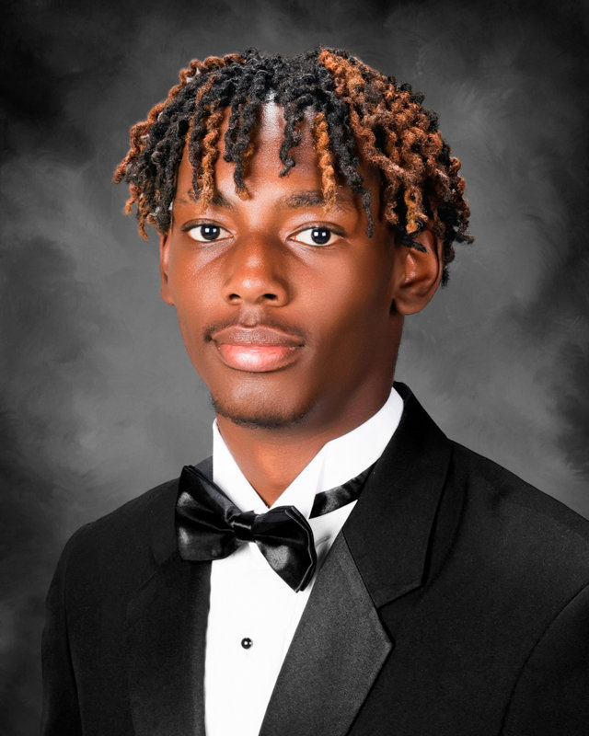
PCHS Class of 2025
Anthony Bell

Slide 18
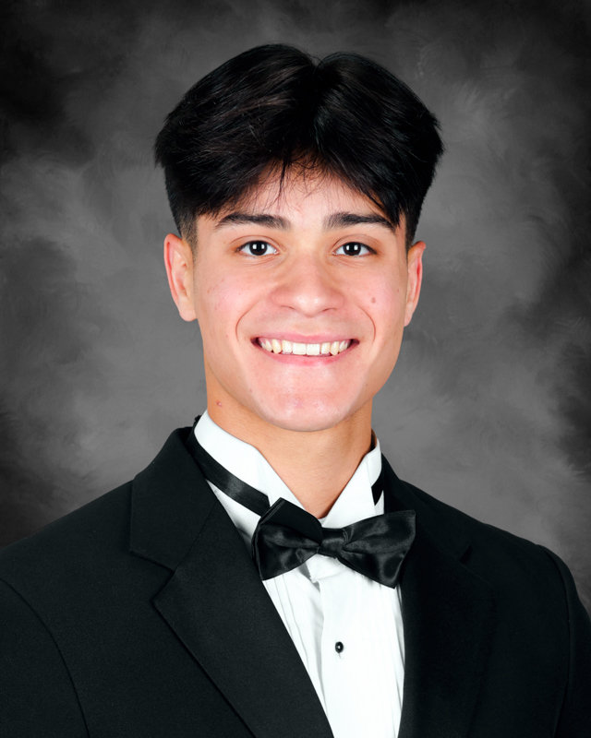
PCHS Class of 2025
Alex Benitez Perales

Slide 19
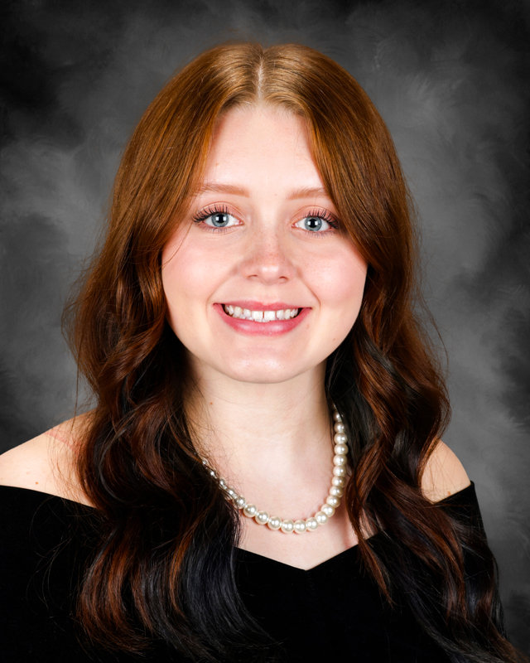
PCHS Class of 2025
Alyssa Biester

Slide 20
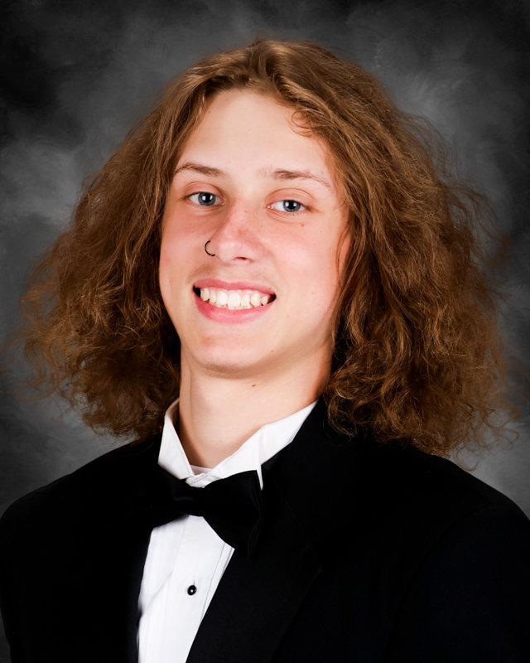
PCHS Class of 2025
Peyton Blair

Slide 21
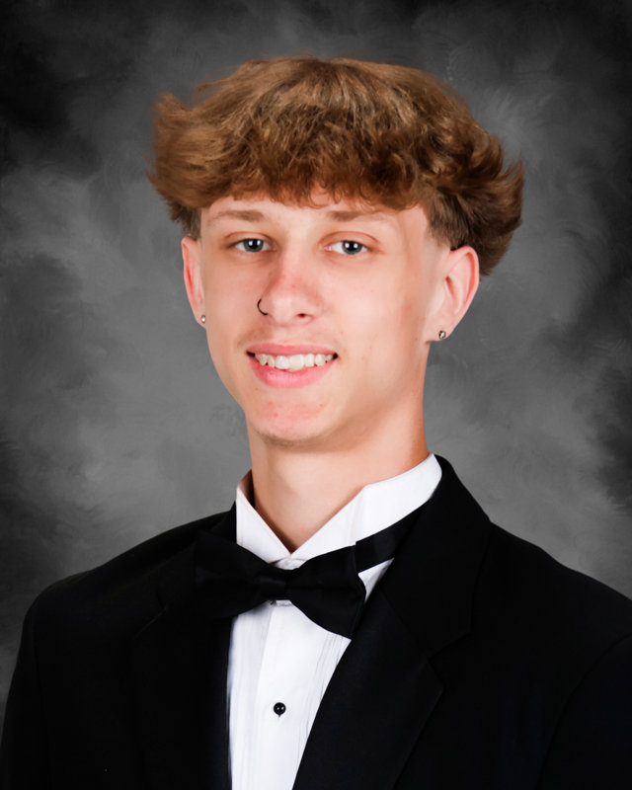
PCHS Class of 2025
Preston Blair

Slide 22
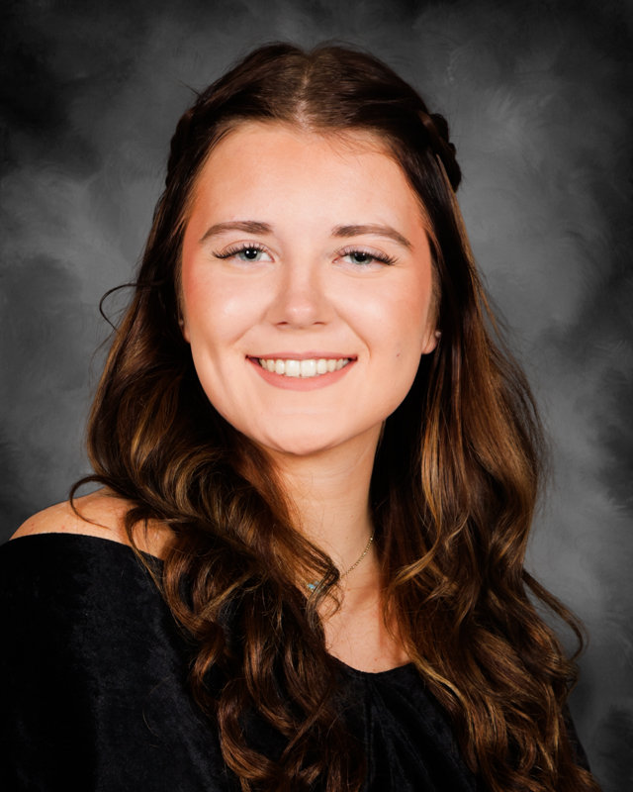
PCHS Class of 2025
Bailey Blankenship

Slide 23
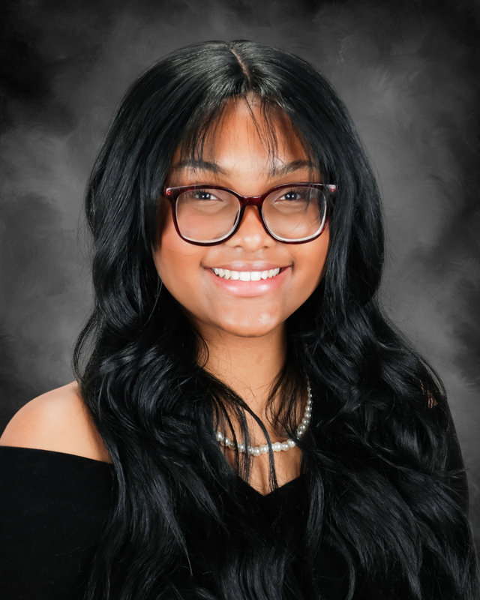
PCHS Class of 2025
Ashikel Boatwright

Slide 24
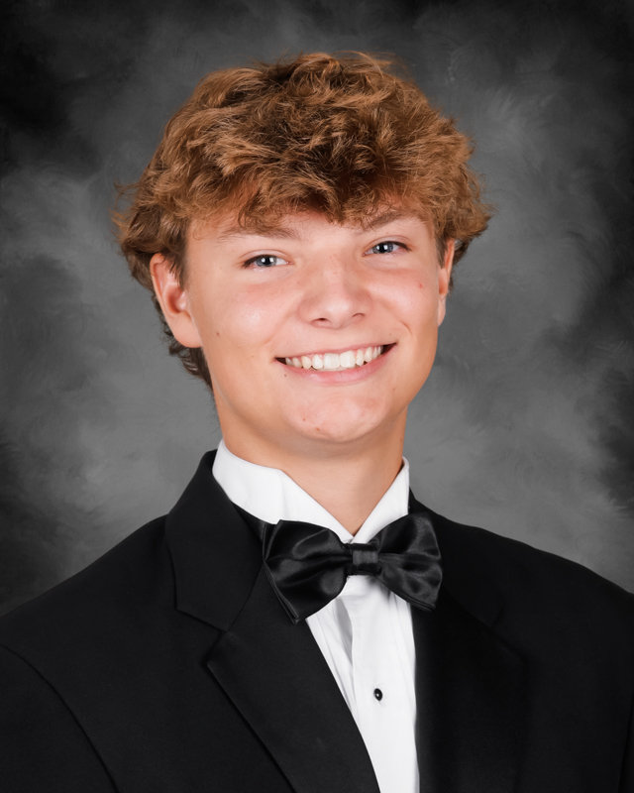
PCHS Class of 2025
Braden Bodnar

Slide 25
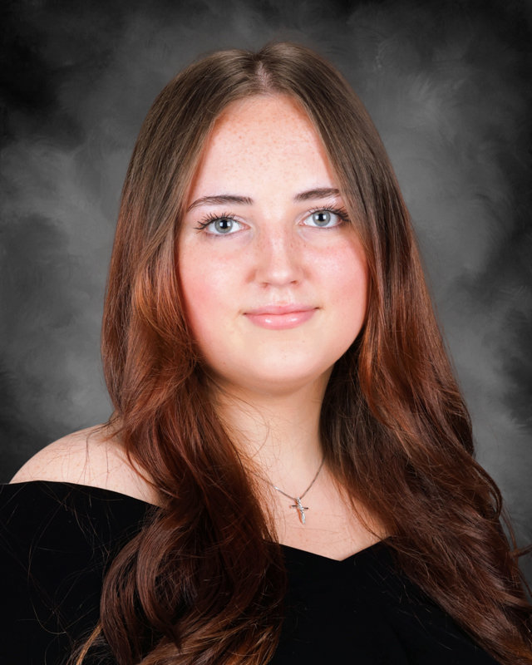
PCHS Class of 2025
Kelsie Boiles

Slide 26
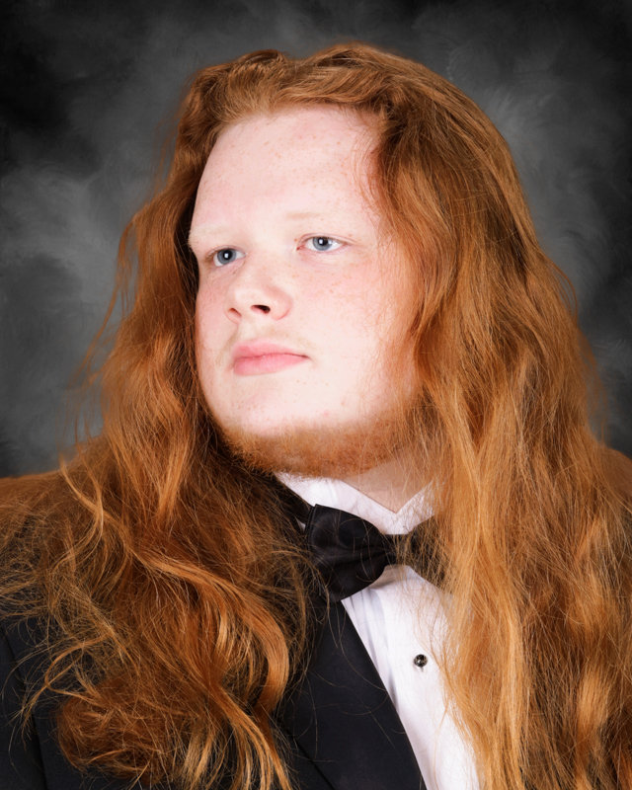
PCHS Class of 2025
Johnathan Bourassa

Slide 27
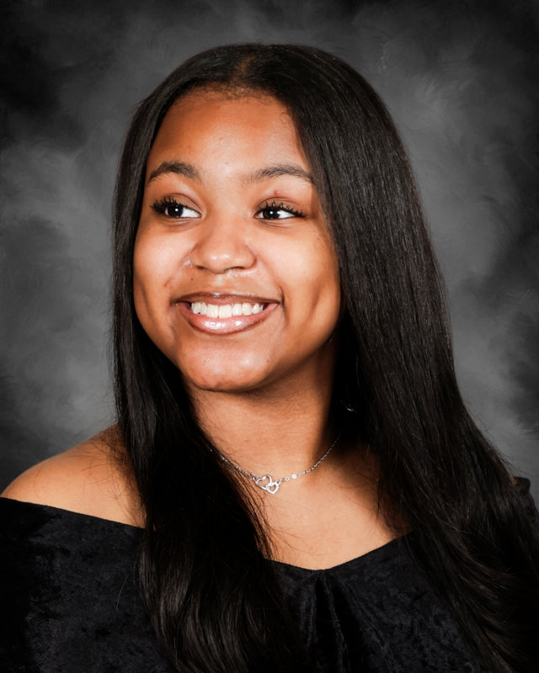
PCHS Class of 2025
Zaria Bowen

Slide 28
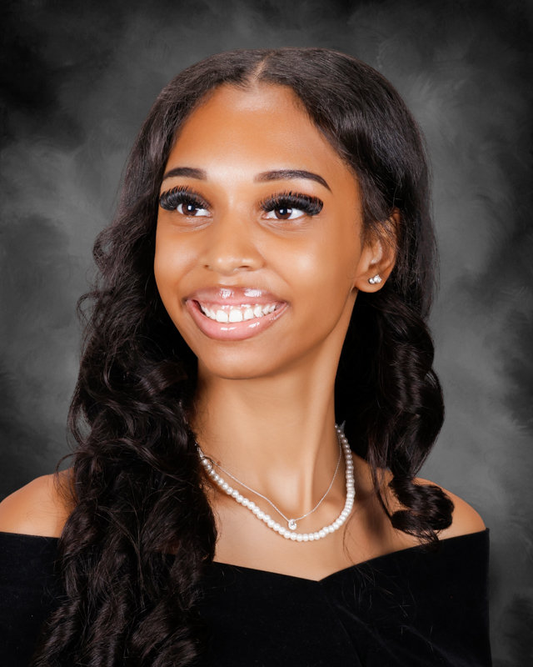
PCHS Class of 2025
Courtney Boyo

Slide 29
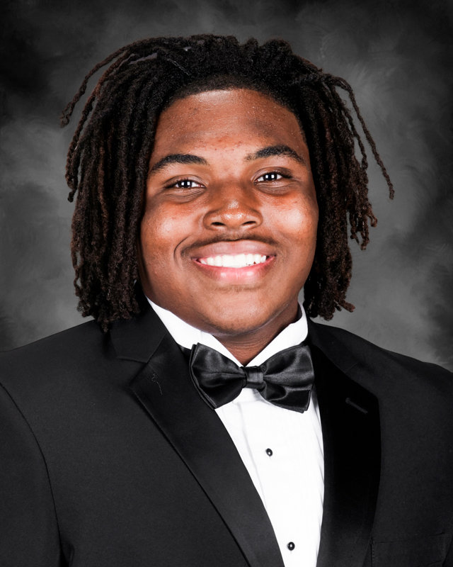
PCHS Class of 2025
Ky’shan Bratten

Slide 30
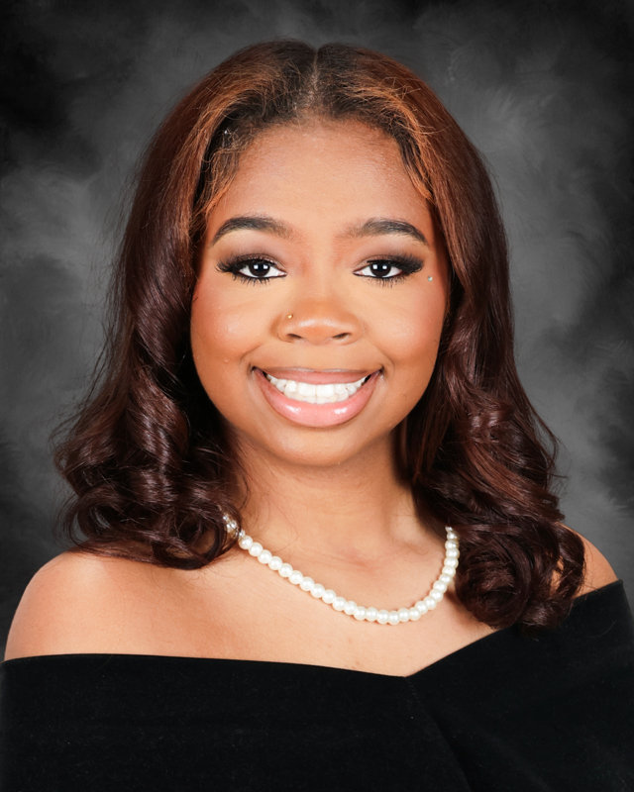
PCHS Class of 2025
I’Lasio Brown

Slide 31
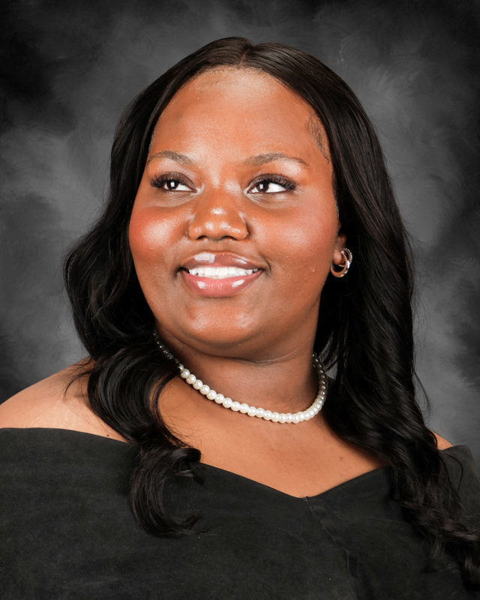
PCHS Class of 2025
Ma’Niyah Brown

Slide 32
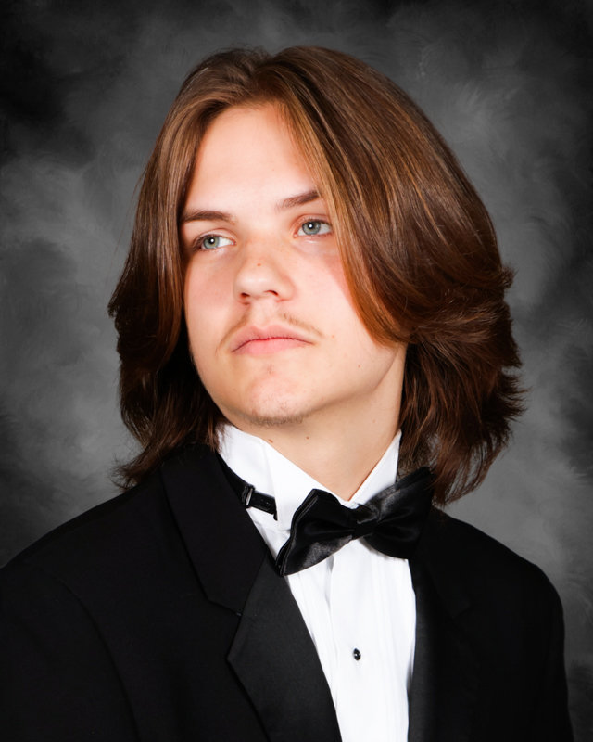
PCHS Class of 2025
Nicholas Brown

Slide 33
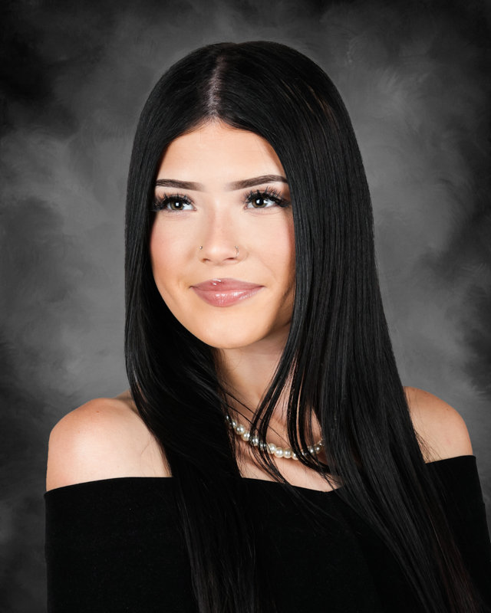
PCHS Class of 2025
Kaitlyn Brown

Slide 34
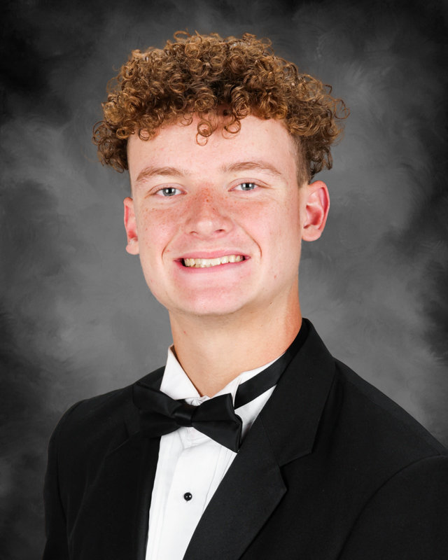
PCHS Class of 2025
Mason Bryant

Slide 35
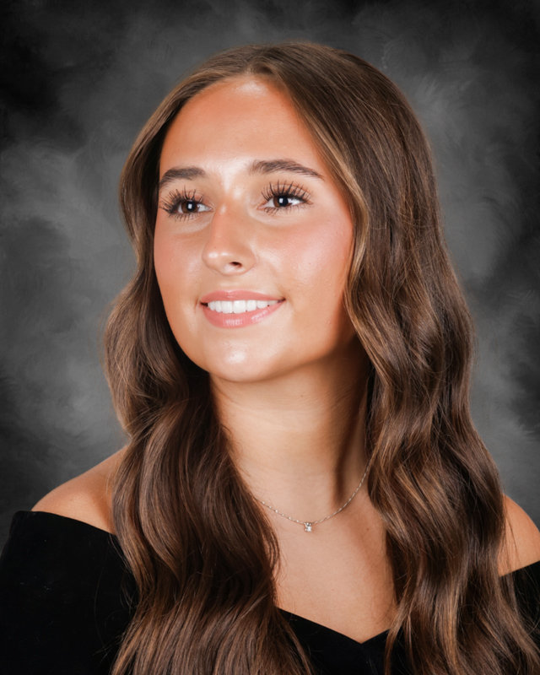
PCHS Class of 2025
Mallorie Burleson

Slide 36
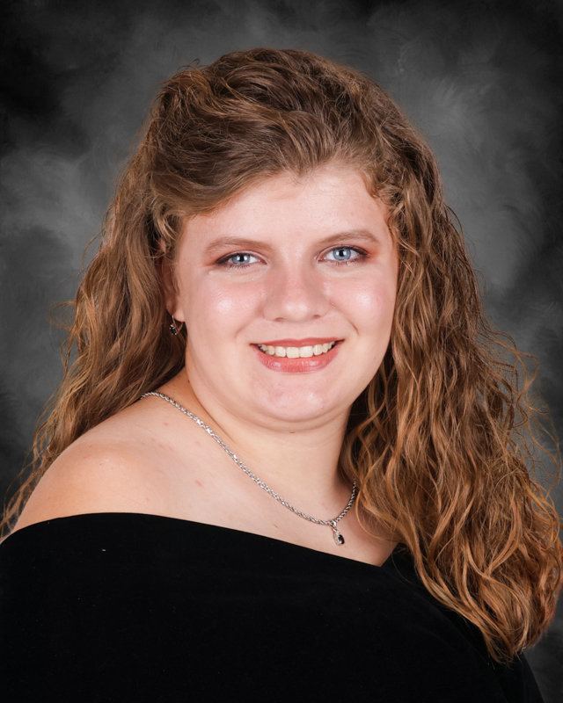
PCHS Class of 2025
Makayla Busby

Slide 37
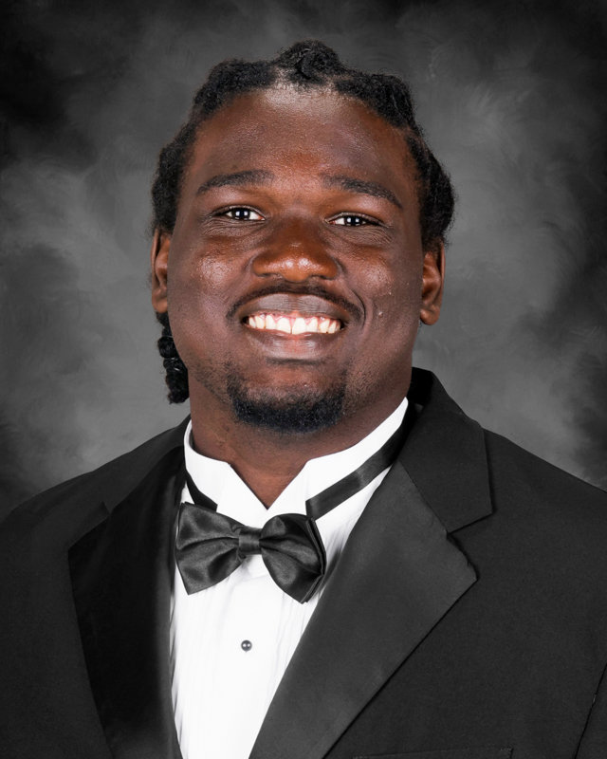
PCHS Class of 2025
Willie Butler

Slide 38
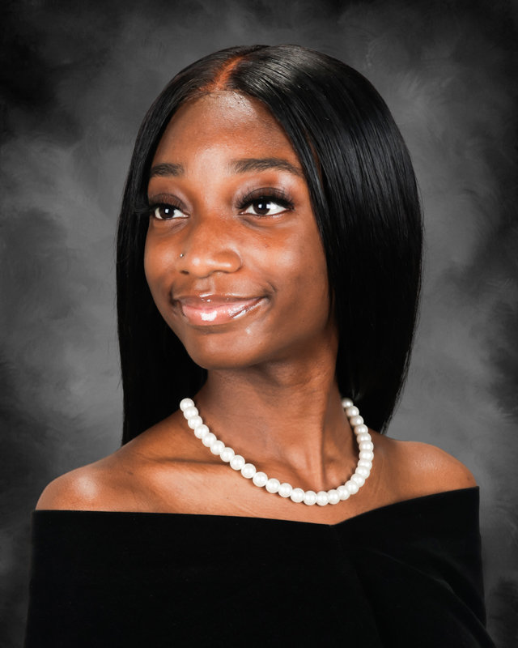
PCHS Class of 2025
Destiny Campbell

Slide 39
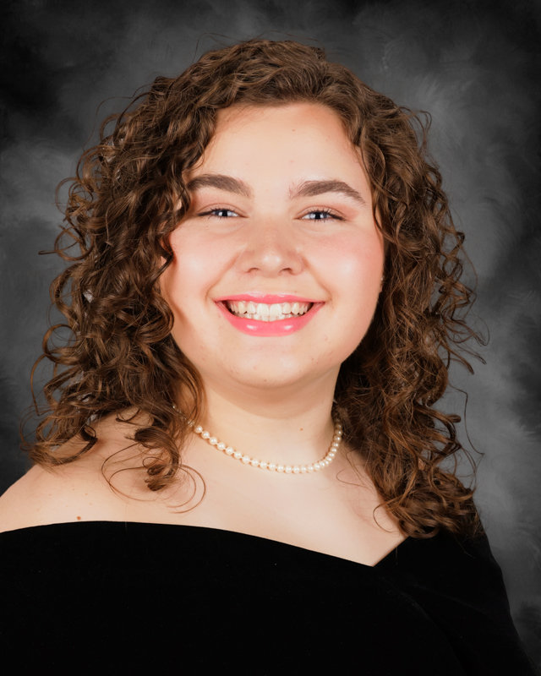
PCHS Class of 2025
Ava Capalbo

Slide 40
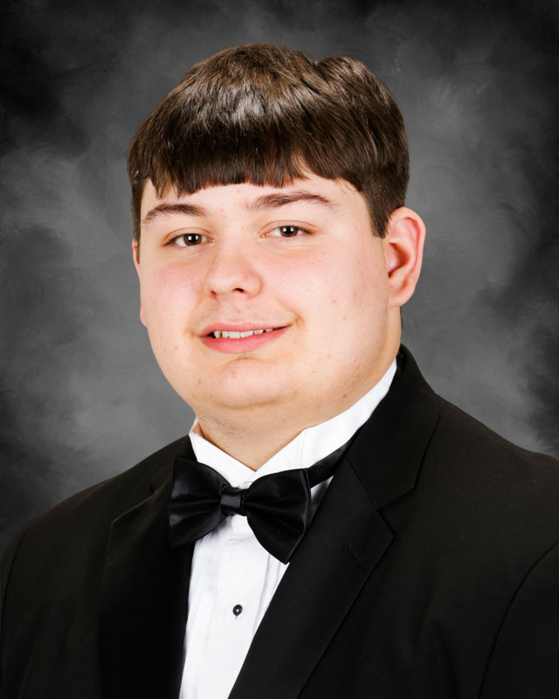
PCHS Class of 2025
Austin Carter

Slide 41
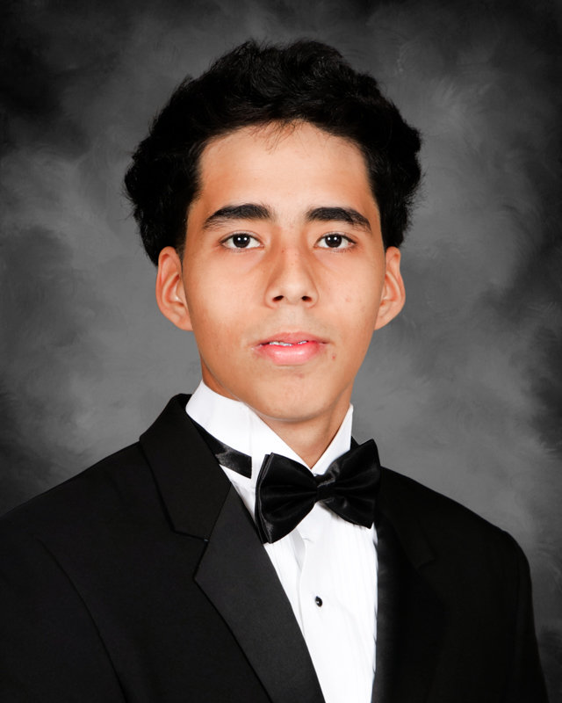
PCHS Class of 2025
Juan Caraval Oropeza

Slide 42
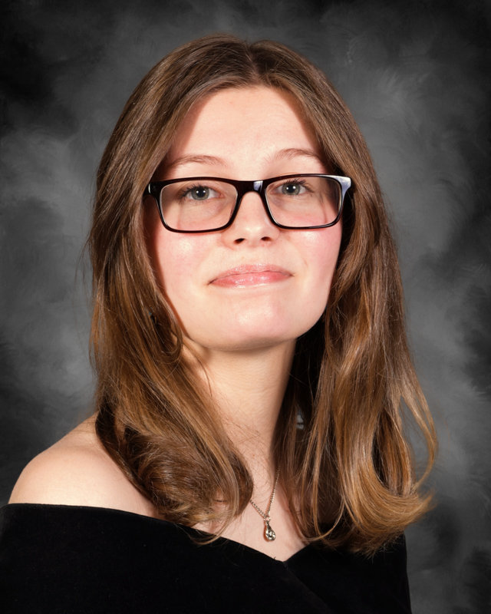
PCHS Class of 2025
Sarah Castille

Slide 43
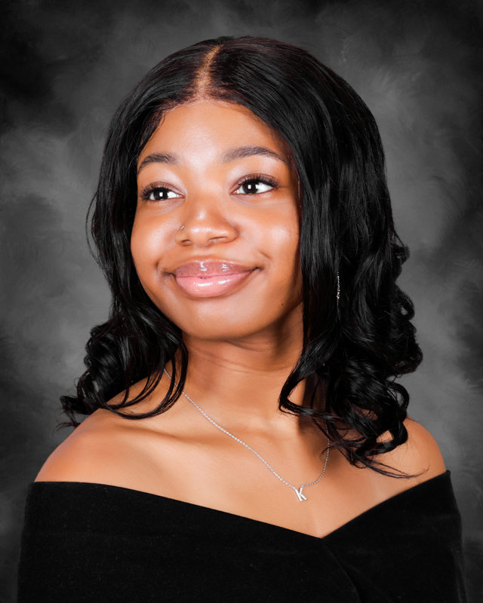
PCHS Class of 2025
Kamaya Cephas

Slide 44
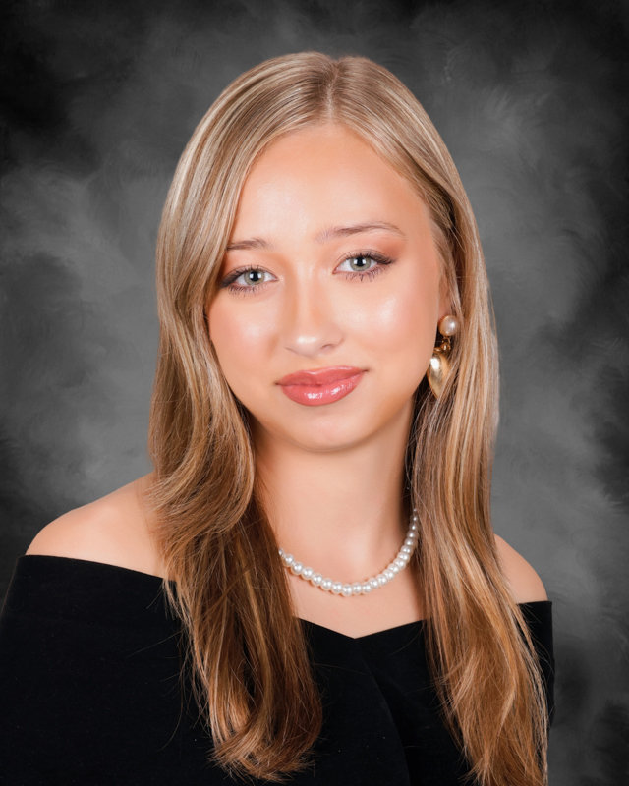
PCHS Class of 2025
Avery Chai

Slide 45
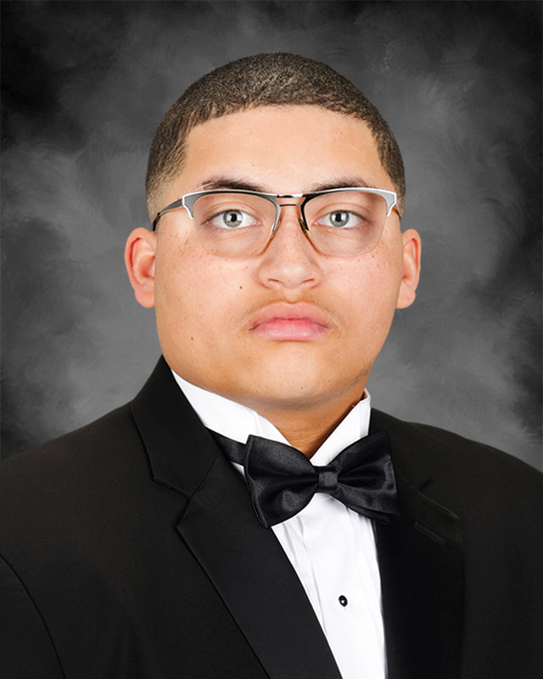
PCHS Class of 2025
Sean Chatman

Slide 46
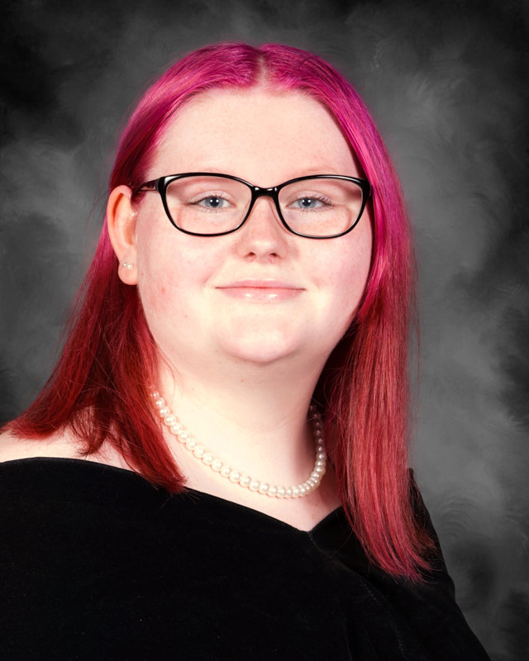
PCHS Class of 2025
Layla Cheek

Slide 47
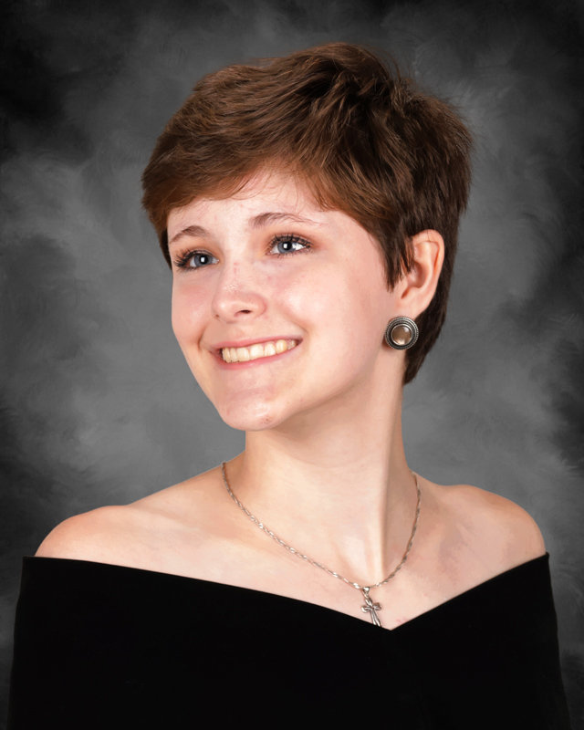
PCHS Class of 2025
Aubrey Christensen

Slide 48
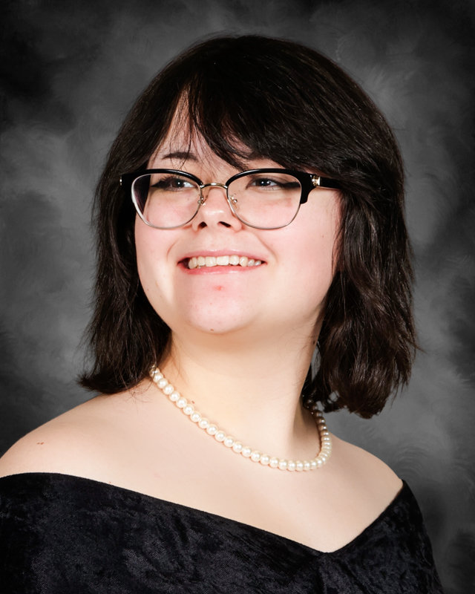
PCHS Class of 2025
Celeste Christopherson

Slide 49
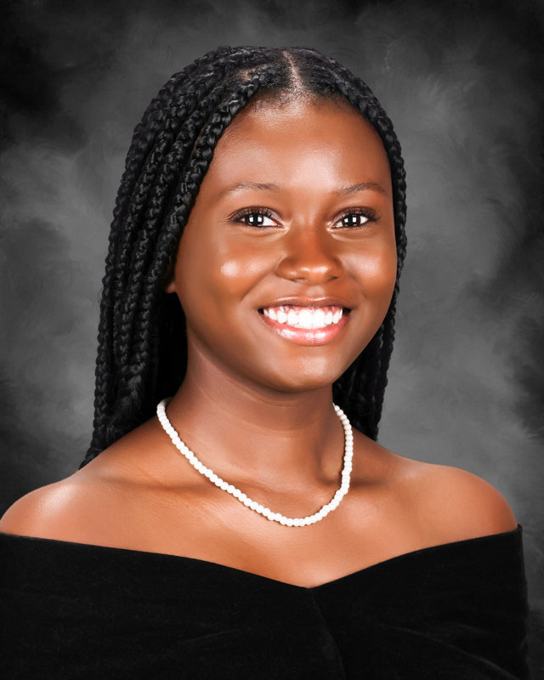
PCHS Class of 2025
Alyssa Cirilo

Slide 50
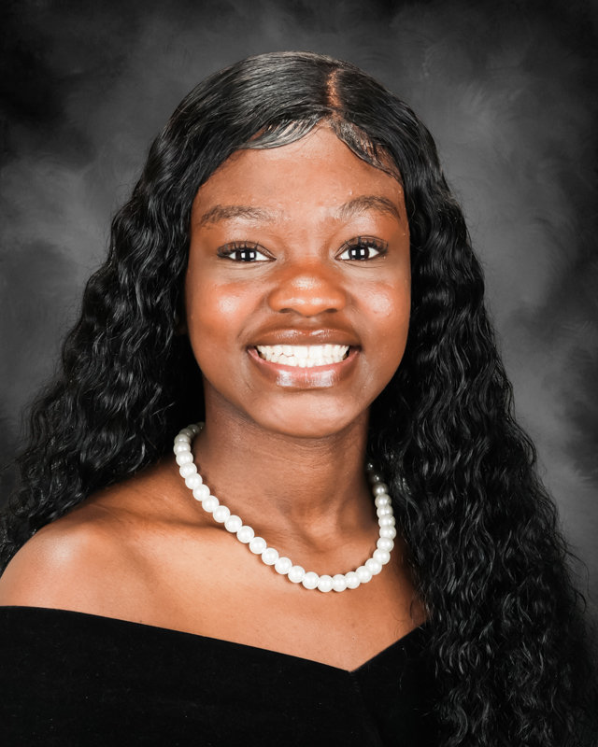
PCHS Class of 2025
Taylor Clarke

Slide 51

PCHS Class of 2025
Jacob Clayton

Slide 52

PCHS Class of 2025
Raionna Coates

Slide 53

PCHS Class of 2025
Randy Coates

Slide 54

PCHS Class of 2025
Tyler Coffey

Slide 55

PCHS Class of 2025
Samaya Cook

Slide 56

PCHS Class of 2025
Katelyn Costley

Slide 57

PCHS Class of 2025
Jewelliana Couch

Slide 58

PCHS Class of 2025
Byron Cox

Slide 59

PCHS Class of 2025
Emily Cunningham

Slide 60

PCHS Class of 2025
Allie Dale

Slide 61

PCHS Class of 2025
Kenendi Daniels

Slide 62

PCHS Class of 2025
Aynsli Davis

Slide 63

PCHS Class of 2025
Leah Davis

Slide 64

PCHS Class of 2025
Satera Davis

Slide 65

PCHS Class of 2025
Cairo Dempsey

Slide 66

PCHS Class of 2025
Christopher Derisma

Slide 67

PCHS Class of 2025
Bianca Dillard

Slide 68

PCHS Class of 2025
Katelin Dockstader

Slide 69

PCHS Class of 2025
Zac Dorris

Slide 70

PCHS Class of 2025
Khennedi Douglas-Sabree

Slide 71

PCHS Class of 2025
Nathaniel Driver

Slide 72

PCHS Class of 2025
Rickiesha Dudley

Slide 73

PCHS Class of 2025
Katarzyna Dudzinski

Slide 74

PCHS Class of 2025
Key’ona Dunn

Slide 75

PCHS Class of 2025
Dey’Shawn Dunn

Slide 76

PCHS Class of 2025
Natylie Ealey

Slide 77

PCHS Class of 2025
Westin East

Slide 78

PCHS Class of 2025
Sanya Eller

Slide 79

PCHS Class of 2025
Clayton English

Slide 80

PCHS Class of 2025
Ana Enriquez-Enriquez

Slide 81

PCHS Class of 2025
Lauryn Eshietedoho

Slide 82

PCHS Class of 2025
Kiarra Evans

Slide 83

PCHS Class of 2025
Chelsea Fako

Slide 84

PCHS Class of 2025
Di’Jamore Felix

Slide 85

PCHS Class of 2025
Rylee Felts

Slide 86

PCHS Class of 2025
Corden Ferguson

Slide 87

PCHS Class of 2025
Heather Foley

Slide 88

PCHS Class of 2025
Tagan Fuller

Slide 89

PCHS Class of 2025
Madelyn Garcia

Slide 90

PCHS Class of 2025
Jakyla Gay

Slide 91

PCHS Class of 2025
Kemora George

Slide 92

PCHS Class of 2025
Zander Gikas

Slide 93

PCHS Class of 2025
Amira Gill

Slide 94

PCHS Class of 2025
Ashlee-Mercy Gnrofoun

Slide 95

PCHS Class of 2025
Jackelin Gonzalez Chavez

Slide 96

PCHS Class of 2025
Arryana Gordon

Slide 97

PCHS Class of 2025
Riley Gordon

Slide 98

PCHS Class of 2025
Lanea Gray

Slide 99

PCHS Class of 2025
Angela Gray

Slide 100

PCHS Class of 2025
Alysse Guano

Slide 101

PCHS Class of 2025
Nairobi Guines

Slide 102

PCHS Class of 2025
Gabrielle Guyton

Slide 103

PCHS Class of 2025
Addysan Hall

Slide 104

PCHS Class of 2025
Yassin Hamada

Slide 105

PCHS Class of 2025
Jaelyn Harding

Slide 106

PCHS Class of 2025
Aniyah Harris

Slide 107

PCHS Class of 2025
Aidyn Haws

Slide 108

PCHS Class of 2025
Wyatt Hendricks

Slide 109

PCHS Class of 2025
Emelinda Hernandez

Slide 110

PCHS Class of 2025
Ashton Herrin

Slide 111

PCHS Class of 2025
Kamari Hicks

Slide 112

PCHS Class of 2025
Lillian Hite

Slide 113

PCHS Class of 2025
Landon Hobbs

Slide 114

PCHS Class of 2025
Stephen Holcombe

Slide 115

PCHS Class of 2025
Elijah Holliday

Slide 116

PCHS Class of 2025
Kahmill Holliday

Slide 117

PCHS Class of 2025
Kaylee Holmes

Slide 118

PCHS Class of 2025
Riley Hopkins

Slide 119

PCHS Class of 2025
Joseph House

Slide 120

PCHS Class of 2025
Michael Howell

Slide 121

PCHS Class of 2025
Aubrey Hulsey

Slide 122

PCHS Class of 2025
Grancer Hutchings

Slide 123

PCHS Class of 2025
Grayson Hutchings

Slide 124

PCHS Class of 2025
Danielle Irvin

Slide 125

PCHS Class of 2025
Carrington Jack

Slide 126

PCHS Class of 2025
Bella Jacobs

Slide 127

PCHS Class of 2025
Hassanatou Jallow

Slide 128

PCHS Class of 2025
Keen-Yean James

Slide 129

PCHS Class of 2025
Chelsea James

Slide 130

PCHS Class of 2025
Gracie Johnson

Slide 131

PCHS Class of 2025
Morgan Johnson

Slide 132

PCHS Class of 2025
Taylor Jordan

Slide 133

PCHS Class of 2025
Lauren Joshua

Slide 134

PCHS Class of 2025
Cristopher Juarez

Slide 135

PCHS Class of 2025
Annalee Keener

Slide 136

PCHS Class of 2025
Dalton Kendrick

Slide 137

PCHS Class of 2025
Shelby Kendrick

Slide 138

PCHS Class of 2025
Emma Kennedy

Slide 139

PCHS Class of 2025
Franklin Kirk

Slide 140

PCHS Class of 2025
Chelsea Knox

Slide 141

PCHS Class of 2025
Logan Kolenky

Slide 142

PCHS Class of 2025
Ethan Kost

Slide 143

PCHS Class of 2025
Kyle Kirk

Slide 144

PCHS Class of 2025
Cheyanna Lacore

Slide 145

PCHS Class of 2025
Classie Lamar

Slide 146

PCHS Class of 2025
Haden Landon

Slide 147

PCHS Class of 2025
Angel Law

Slide 148

PCHS Class of 2025
Jayden Lawson

Slide 149

PCHS Class of 2025
Brianna Legg

Slide 150

PCHS Class of 2025
Isabel Lewanick

Slide 151

PCHS Class of 2025
Jackson Lewis

Slide 152

PCHS Class of 2025
Riley Linde

Slide 153

PCHS Class of 2025
Joshua Locklear

Slide 154

PCHS Class of 2025
Aritzson Louis

Slide 155

PCHS Class of 2025
Mikayla Luna-Chambers

Slide 156

PCHS Class of 2025
Levi Lycans

Slide 157

PCHS Class of 2025
Alex Mace

Slide 158

PCHS Class of 2025
Jada Malcolm

Slide 159

PCHS Class of 2025
Mackenzie Mann

Slide 160

PCHS Class of 2025
Andrew Manning

Slide 161

PCHS Class of 2025
Katelynn Martin

Slide 162

PCHS Class of 2025
Alejandro Mata Perez

Slide 163

PCHS Class of 2025
Anna Mattick

Slide 164

PCHS Class of 2025
Haley May

Slide 165

PCHS Class of 2025
Sophia Mazzuchelli

Slide 166

PCHS Class of 2025
Gabrielle McBride

Slide 167

PCHS Class of 2025
Jayden McCauley

Slide 168

PCHS Class of 2025
Alana McCleary

Slide 169

PCHS Class of 2025
Jordan McCrary

Slide 170

PCHS Class of 2025
Wyatt McCurdy

Slide 171

PCHS Class of 2025
Christopher McGirt

Slide 172

PCHS Class of 2025
Mackenzie McMurtry

Slide 173

PCHS Class of 2025
Precious Melton

Slide 174

PCHS Class of 2025
Kaylee Mendoza

Slide 175

PCHS Class of 2025
Bella Miller

Slide 176

PCHS Class of 2025
Joseph Mire

Slide 177

PCHS Class of 2025
Sean Mohr

Slide 178

PCHS Class of 2025
Harriet Momanyi

Slide 179

PCHS Class of 2025
Stephanie Moore

Slide 180

PCHS Class of 2025
Zaynab Moore

Slide 181

PCHS Class of 2025
Deja Moore

Slide 182

PCHS Class of 2025
Kamora Morris

Slide 183

PCHS Class of 2025
Anderson Moye

Slide 184

PCHS Class of 2025
Avery Mundy

Slide 185

PCHS Class of 2025
Gloria Mwangi

Slide 186

PCHS Class of 2025
Sergio Neyra

Slide 187

PCHS Class of 2025
Sole Nixon

Slide 188

PCHS Class of 2025
Diamanta Nixon

Slide 189

PCHS Class of 2025
Skye Njoroge

Slide 190

PCHS Class of 2025
Angel Noel

Slide 191

PCHS Class of 2025
April Ocampo

Slide 192

PCHS Class of 2025
Maria Ochoa

Slide 193

PCHS Class of 2025
Jackson Oden

Slide 194

PCHS Class of 2025
Chiamaka Okoroafor

Slide 195

PCHS Class of 2025
Rylan Olds

Slide 196

PCHS Class of 2025
Katherine Orewiler

Slide 197

PCHS Class of 2025
Savannah Palmer

Slide 198

PCHS Class of 2025
Eva Palumbo

Slide 199

PCHS Class of 2025
Kaili Parker

Slide 200

PCHS Class of 2025
Madelynn Patrick

Slide 201

PCHS Class of 2025
Arden Patterson

Slide 202

PCHS Class of 2025
Adam Pepin

Slide 203

PCHS Class of 2025
McKenzie Perkins

Slide 204

PCHS Class of 2025
Abigail Perkins

Slide 205

PCHS Class of 2025
Ethan Pich

Slide 206

PCHS Class of 2025
Desteny Pickel

Slide 207

PCHS Class of 2025
Dusten Pickel

Slide 208

PCHS Class of 2025
Luke Pike

Slide 209

PCHS Class of 2025
Emir Pinar

Slide 210

PCHS Class of 2025
Joseph Pittman

Slide 211

PCHS Class of 2025
Kourtney Porter

Slide 212

PCHS Class of 2025
Faith Powell

Slide 213

PCHS Class of 2025
Zayden Pugh

Slide 214

PCHS Class of 2025
Ivy Qualls

Slide 215

PCHS Class of 2025
Joshua Quezada

Slide 216

PCHS Class of 2025
Caleb Rabren

Slide 217

PCHS Class of 2025
Hunter Rabun

Slide 218

PCHS Class of 2025
Kennadi Reese

Slide 219

PCHS Class of 2025
Ashley Reyes-Alvarado

Slide 220

PCHS Class of 2025
Chloe Richards

Slide 221

PCHS Class of 2025
Shamar Ridges

Slide 222

PCHS Class of 2025
Zariah Ridley

Slide 223

PCHS Class of 2025
Lillie Riggs

Slide 224

PCHS Class of 2025
Gloria Riles

Slide 225

PCHS Class of 2025
Kirralynn Roman Rodriguez

Slide 226

PCHS Class of 2025
Rachel Rogers

Slide 227

PCHS Class of 2025
Jacob Rogers

Slide 228

PCHS Class of 2025
Joshua Rogers

Slide 229

PCHS Class of 2025
Nathaniel Roper

Slide 230

PCHS Class of 2025
Elias Rowland

Slide 231

PCHS Class of 2025
Blandine Saint Jean

Slide 232

PCHS Class of 2025
Gerardo Salazar

Slide 233

PCHS Class of 2025
Ana Sanchez

Slide 234

PCHS Class of 2025
Jovaughn Savage

Slide 235

PCHS Class of 2025
Addyson Schlais

Slide 236

PCHS Class of 2025
Elise Schwartz

Slide 237

PCHS Class of 2025
Ethan Schwartz

Slide 238

PCHS Class of 2025
Gernyvia Scott

Slide 239

PCHS Class of 2025
Emilie Scruggs

Slide 240

PCHS Class of 2025
Chloe Sellers

Slide 241

PCHS Class of 2025
Brenden Sexton

Slide 242

PCHS Class of 2025
Alahna Shattles

Slide 243

PCHS Class of 2025
Dayvon Cipriano

Slide 244

PCHS Class of 2025
Sydney Shirley

Slide 245

PCHS Class of 2025
George Shumpert

Slide 246

PCHS Class of 2025
Alexa Singh

Slide 247

PCHS Class of 2025
Baylie Smith

Slide 248

PCHS Class of 2025
Callie Smith

Slide 249

PCHS Class of 2025
Ayanna Smith

Slide 250

PCHS Class of 2025
Oluwatobiloba Soneyin

Slide 251

PCHS Class of 2025
Joel Soto

Slide 252

PCHS Class of 2025
Ashton Soublis

Slide 253

PCHS Class of 2025
Abigail St. Clair

Slide 254

PCHS Class of 2025
Quiara Stearn

Slide 255

PCHS Class of 2025
Jeb Stewart

Slide 256

PCHS Class of 2025
Kyrah Stocks

Slide 257

PCHS Class of 2025
Amari Stothart

Slide 258

PCHS Class of 2025
Landon Stout

Slide 259

PCHS Class of 2025
Robert Olen Strickland

Slide 260

PCHS Class of 2025
Laila Swanson

Slide 261

PCHS Class of 2025
Sebastian Swearingen

Slide 262

PCHS Class of 2025
James Talley

Slide 263

PCHS Class of 2025
Catherine Temple

Slide 264

PCHS Class of 2025
Breyon Thomas

Slide 265

PCHS Class of 2025
Treyvon Thomas

Slide 266

PCHS Class of 2025
Kaitlin Thomason

Slide 267

PCHS Class of 2025
Riley Thomason

Slide 268

PCHS Class of 2025
Bryce Thomason

Slide 269

PCHS Class of 2025
Karmel Thompson

Slide 270

PCHS Class of 2025
Lucas Thompson

Slide 271

PCHS Class of 2025
Yulianna Torres

Slide 272

PCHS Class of 2025
Kinsley Tumlin

Slide 273

PCHS Class of 2025
Jasmine Turner

Slide 274

PCHS Class of 2025
Jacob Tutwiler

Slide 275

PCHS Class of 2025
Yasmin Valentine

Slide 276

PCHS Class of 2025
Jasmin Valenzuela

Slide 277

PCHS Class of 2025
Laura Vargas Fierro

Slide 278

PCHS Class of 2025
Brookelynn Vaughn

Slide 279

PCHS Class of 2025
Yandel Vazquez

Slide 280

PCHS Class of 2025
Cesar Vazquez

Slide 281

PCHS Class of 2025
Haley Velazquez

Slide 282

PCHS Class of 2025
Samia Vernet

Slide 283

PCHS Class of 2025
Aidan Wade

Slide 284

PCHS Class of 2025
Cameron Ealey

Slide 285

PCHS Class of 2025
Noah Walker

Slide 286

PCHS Class of 2025
Taylor Waller

Slide 287

PCHS Class of 2025
Isabelle Walters

Slide 288

PCHS Class of 2025
KenYala Ware

Slide 289

PCHS Class of 2025
Morgan Warren

Slide 290

PCHS Class of 2025
Joslyn Washington

Slide 291

PCHS Class of 2025
Abegail Waters

Slide 292

PCHS Class of 2025
London Waterson

Slide 293

PCHS Class of 2025
Alexis Watson

Slide 294

PCHS Class of 2025
Cailey Webb

Slide 295

PCHS Class of 2025
Daniyla Webb

Slide 296

PCHS Class of 2025
Shaniya Webb

Slide 297

PCHS Class of 2025
Chloe Weiss

Slide 298

PCHS Class of 2025
Caroline Wenkel

Slide 299

PCHS Class of 2025
Sophia Wesselmann

Slide 300

PCHS Class of 2025
Blair Whisner

Slide 301

PCHS Class of 2025
Morgan Whited

Slide 302

PCHS Class of 2025
Ryan Whitley

Slide 303

PCHS Class of 2025
Jane Widner

Slide 304

PCHS Class of 2025
Timothy Wilder

Slide 305

PCHS Class of 2025
Shaniya Williams

Slide 306

PCHS Class of 2025
Kaitlyn Witt

Slide 307

PCHS Class of 2025
Bryle Wood

Slide 308

PCHS Class of 2025
Peyton Worrell

Slide 309

PCHS Class of 2025
Kamryn Wright

Slide 310

PCHS Class of 2025
Bailey Young

Slide 311

PCHS Class of 2025
Adrian Zapata

Slide 312

PCHS Class of 2025
Samiha Zuniga

Slide 313

PCHS Class of 2025
Madison Foster

Slide 314

PCHS Class of 2025
Kiara Jackson

Slide 315

PCHS Class of 2025
Derick McCallum, Jr.

Slide 316

PCHS Class of 2025
Jameson Cairney

Slide 317

PCHS Class of 2025
Elizabeth Ledford

Slide 318

PCHS Class of 2025
Colby Lycans

Slide 319

PCHS Class of 2025
Nigel Lane

Slide 320

PCHS Class of 2025
Malakai Stackens

Slide 321

PCHS Class of 2025
Kaniya Stackens

Slide 322

PCHS Class of 2025
Cheyenne Walton

Slide 323

PCHS Class of 2025
Isobel Bagley

Slide 324

PCHS Class of 2025
Elijah Hutto

Slide 325

PCHS Class of 2025
Kalyn Haynes

Slide 326

PCHS Class of 2025
Carson Cain

Slide 327

PCHS Class of 2025
Willow Cheek

Slide 328

PCHS Class of 2025
Matthew Nakao

Slide 329

PCHS Class of 2025
Chloe Schroder

Slide 330

PCHS Class of 2025
Daniqueo Dungey

Slide 331

PCHS Class of 2025
Jalen Moreland

Slide 332

PCHS Class of 2025
Kelsey Davidson

Slide 333

PCHS Class of 2025
Skyler Ball

Slide 334

PCHS Class of 2025
Alyssa Waddell

Slide 335

PCHS Class of 2025
Stephanie Taylor

Slide 336

PCHS Class of 2025
Allison Ensley

Slide 337

PCHS Class of 2025
Isaiah Wynn

Slide 338

PCHS Class of 2025
Vanesa Velasco

Slide 339

PCHS Class of 2025
Robert Rowe

Slide 340

PCHS Class of 2025
Zachary McCleary

Slide 341

PCHS Class of 2025
Anaia Mack

Slide 342

PCHS Class of 2025
Jakayla Brock-Bey

Slide 343

PCHS Class of 2025
Arin Poitier

Slide 344

PCHS Class of 2025
Adam Lugo

Slide 345

PCHS Class of 2025
Alexis Johnson

Slide 346

PCHS Class of 2025
Amaya Blount

Slide 347

PCHS Class of 2025
Neilsen Ramos

Slide 348

PCHS Class of 2025
Quinterious Davis

Slide 349

PCHS Class of 2025
Tanner Bowers

Slide 350

PCHS Class of 2025
Rrianah Mason

Slide 351

PCHS Class of 2025
Jakyriah Touray

Slide 352

PCHS Class of 2025
Asher Henson

